Slide 1

Inject 6
Physical and Infrastructure Effects Briefing
February 4, 2022
2015 PDC
Mark Boslough & Barbara Jennings
Sandia National Labs
Albuquerque, NM
Bill Fogleman, GRIT – Mapping
Paul Chodas – JPL - Trajectory
Souheil Ezzedine – LLNL – Tsunami
EXERCISE
Sandia is a multiprogram laboratory operated by Sandia Corporation, a Lockheed Martin Company,
for the United States Department of Energy under contract DE-AC04-94AL85000.
Notes:
August 1972 fireball over western US

Slide 2
What we have been told
Deflection partially successful
Entry speed: 16 km/s (36,000 mph, ~mach 47)
Size: Up to 100 meters diameter
Composition: Stone, density 2.2-3.3 g/cm³
50 Megaton impact cannot be ruled out
Impact is certain: September 3, 2022

Slide 3
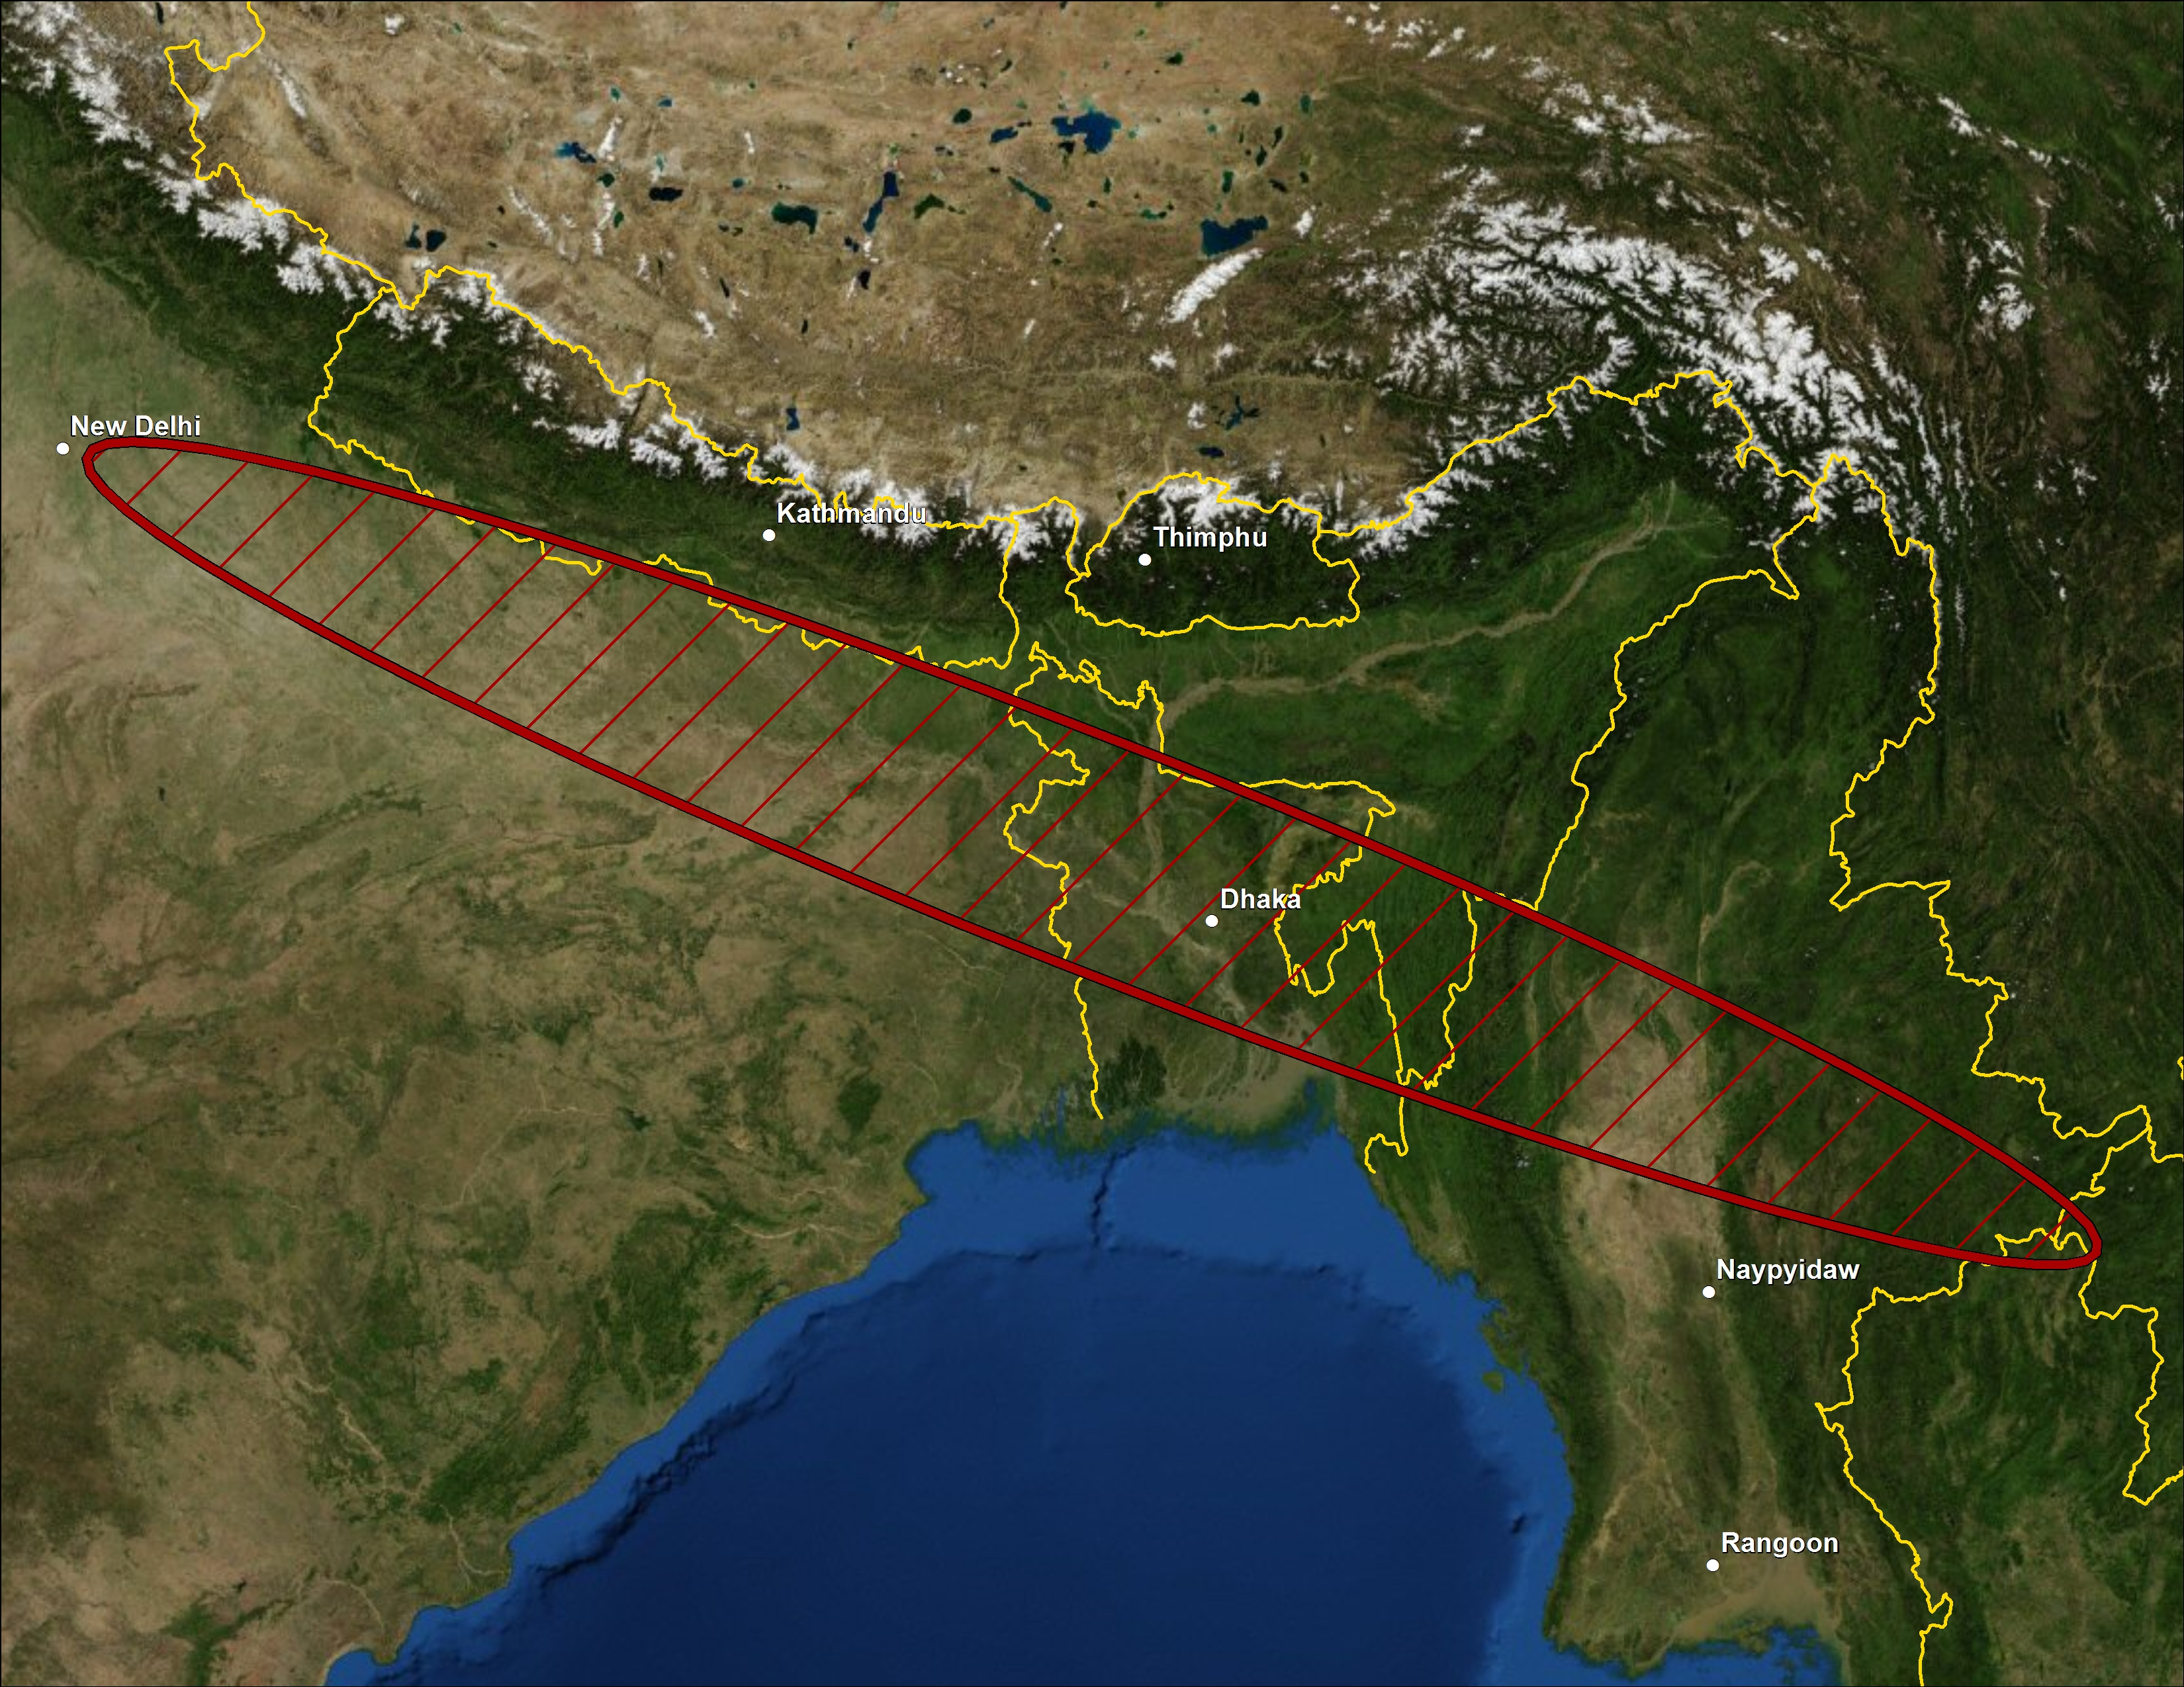

Slide 4
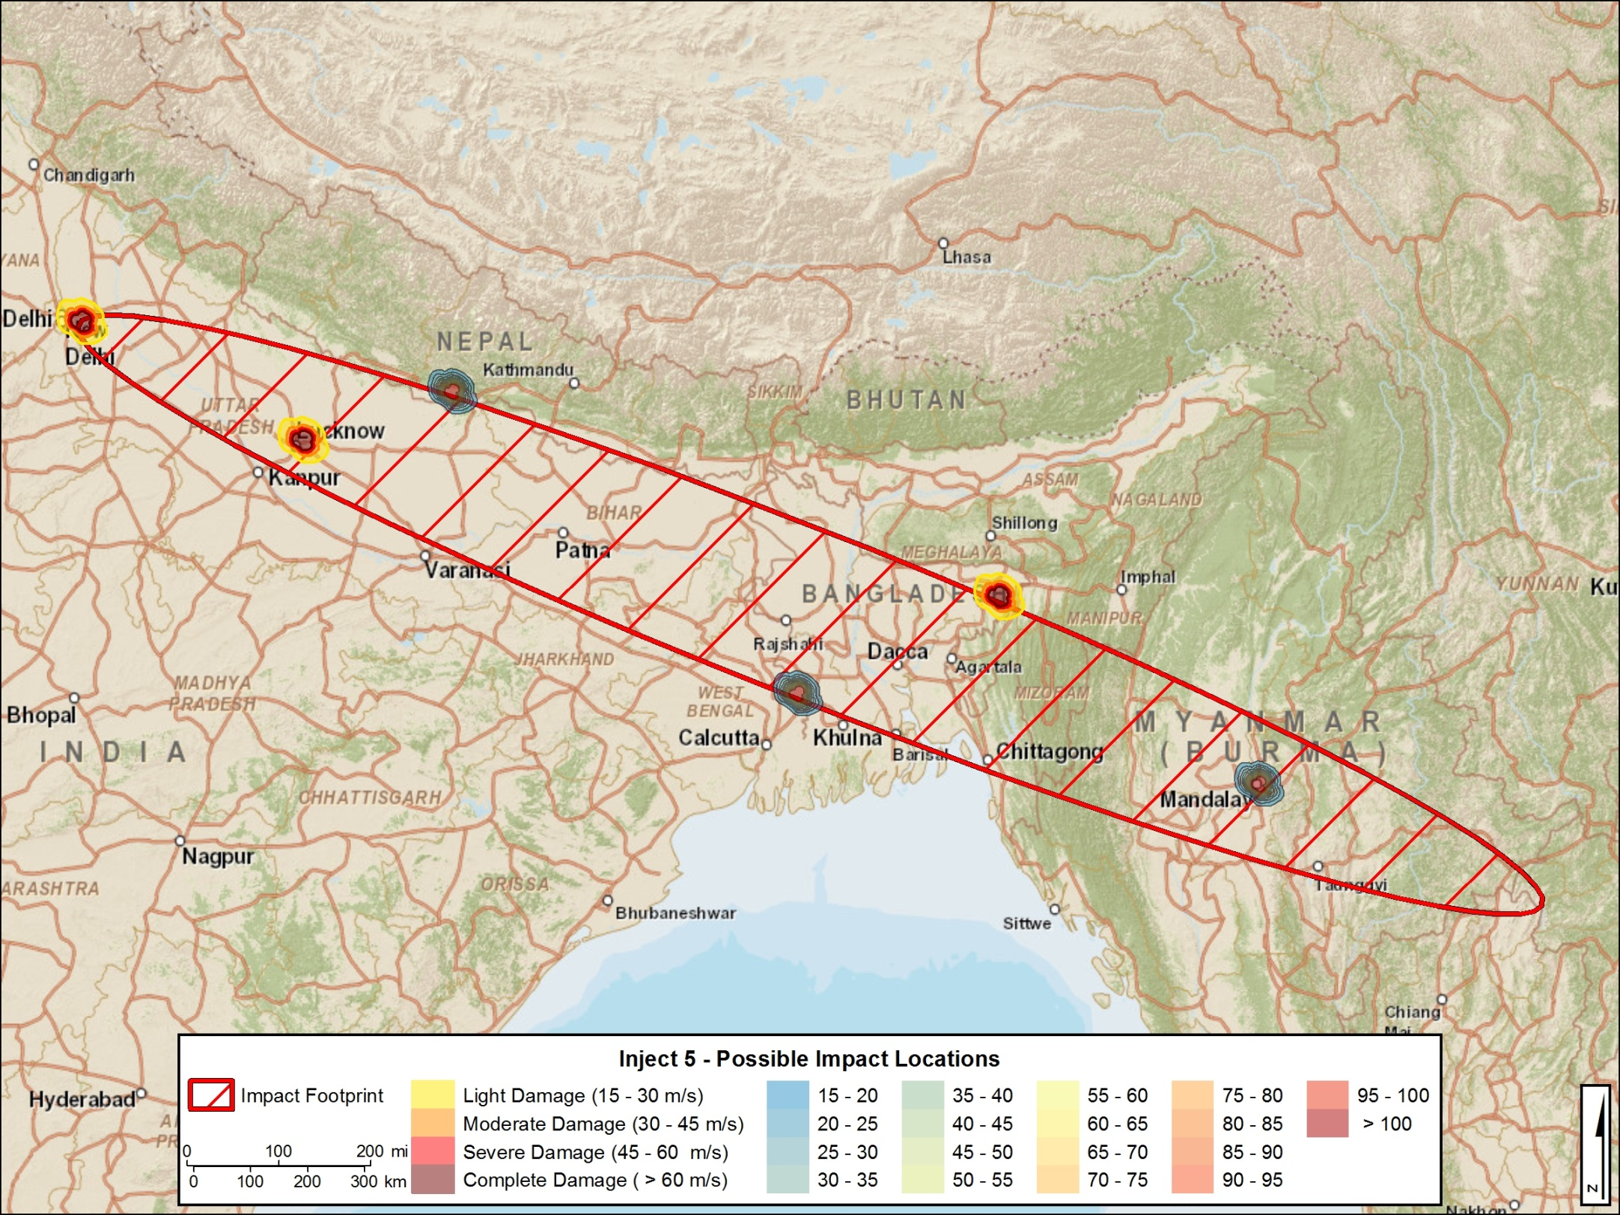
Country | Potentially Impacted Population (2020)
Bangladesh | 136,177,408
India | 219,941,526
Lao | 91,773
Myanmar | 13,321,088
Thailand | 524,225
Total Population | 370,056,019

Slide 5
PDC2015 Scenario:
A Probabilistic Risk Analysis
Jason C. Reinhardt
Stanford University
reinhardt@stanford.edu

Slide 6
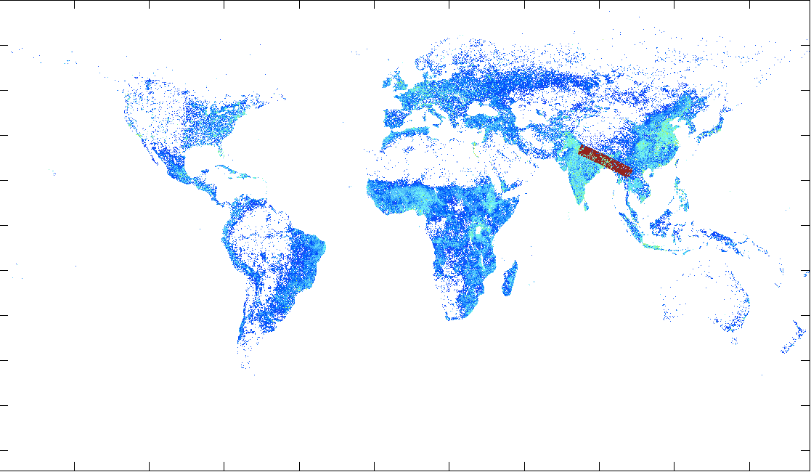
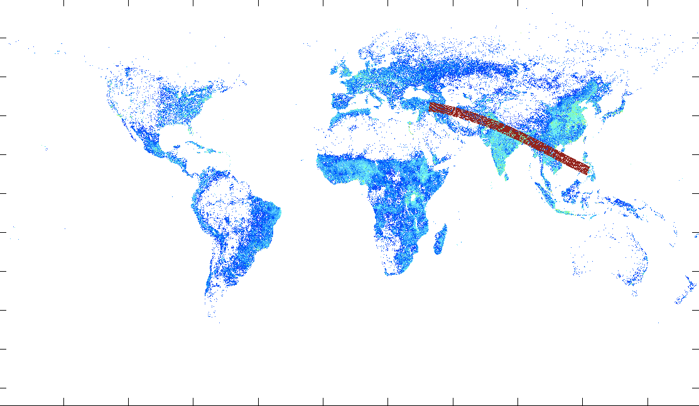
The Feb. 2022 Risk Corridor and Human Population

Slide 7
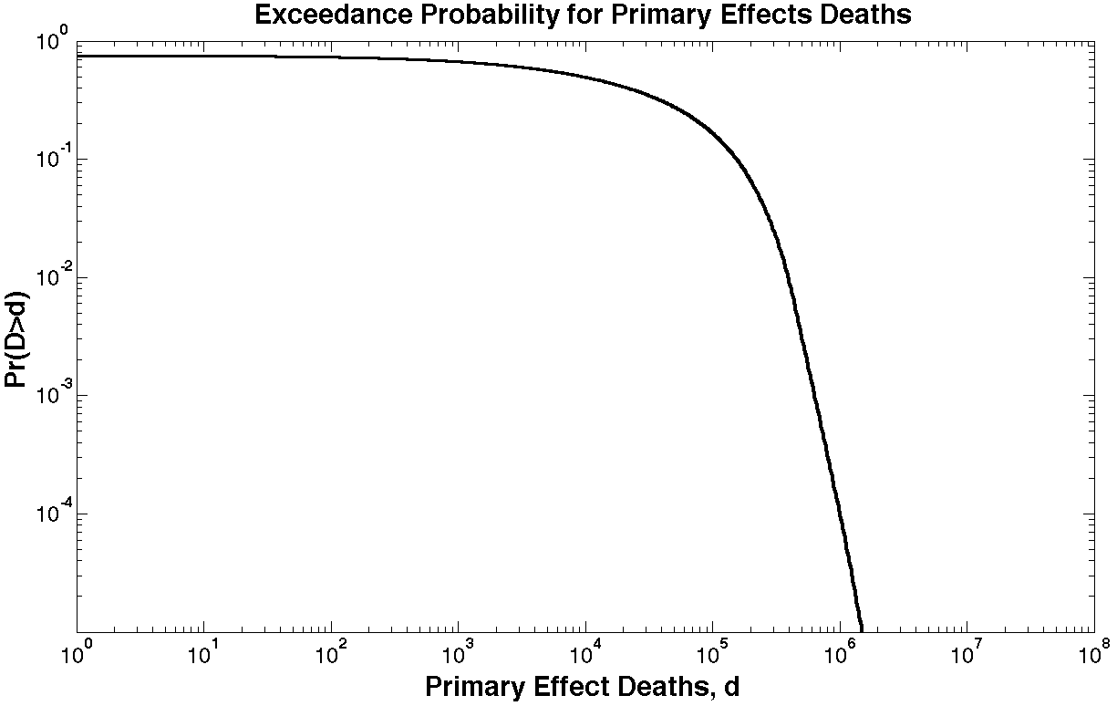
Distribution over fatalities (Feb. 4, 2022)
Pr(Impact) = 1
E(d) = 48645
Pr(d>10⁶) =9.4x10⁻⁵

Slide 8
Probability of Total Fatalities
Total Fatalities (d) | ~Pr(d in Range)
d < 10² | 0.271
10² < d < 10³ | 0.061
10³ < d < 10⁴ | 0.175
10⁴ < d < 10⁵ | 0.328
10⁵ < d < 10⁶ | 0.164
10⁶ < d | <0.001

