Slide 1

Inject 5
Physical and Infrastructure Effects Briefing
February 4, 2021
2015 PDC
Mark Boslough & Barbara Jennings
Sandia National Labs
Albuquerque, NM
Bill Fogleman, GRIT – Mapping
Paul Chodas – JPL - Trajectory
Souheil Ezzedine – LLNL – Tsunami
EXERCISE
Sandia is a multiprogram laboratory operated by Sandia Corporation, a Lockheed Martin Company,
for the United States Department of Energy under contract DE-AC04-94AL85000.
Notes:
August 1972 fireball over western US

Slide 2
What we have been told
Deflection partially successful
Entry speed: 16 km/s (36,000 mph, ~mach 47)
Size: up to 100 meters diameter
Composition: Stone, density 2.2-3.3 g/cm³
50 Megaton impact cannot be ruled out
Impact is certain: September 3, 2022

Slide 3
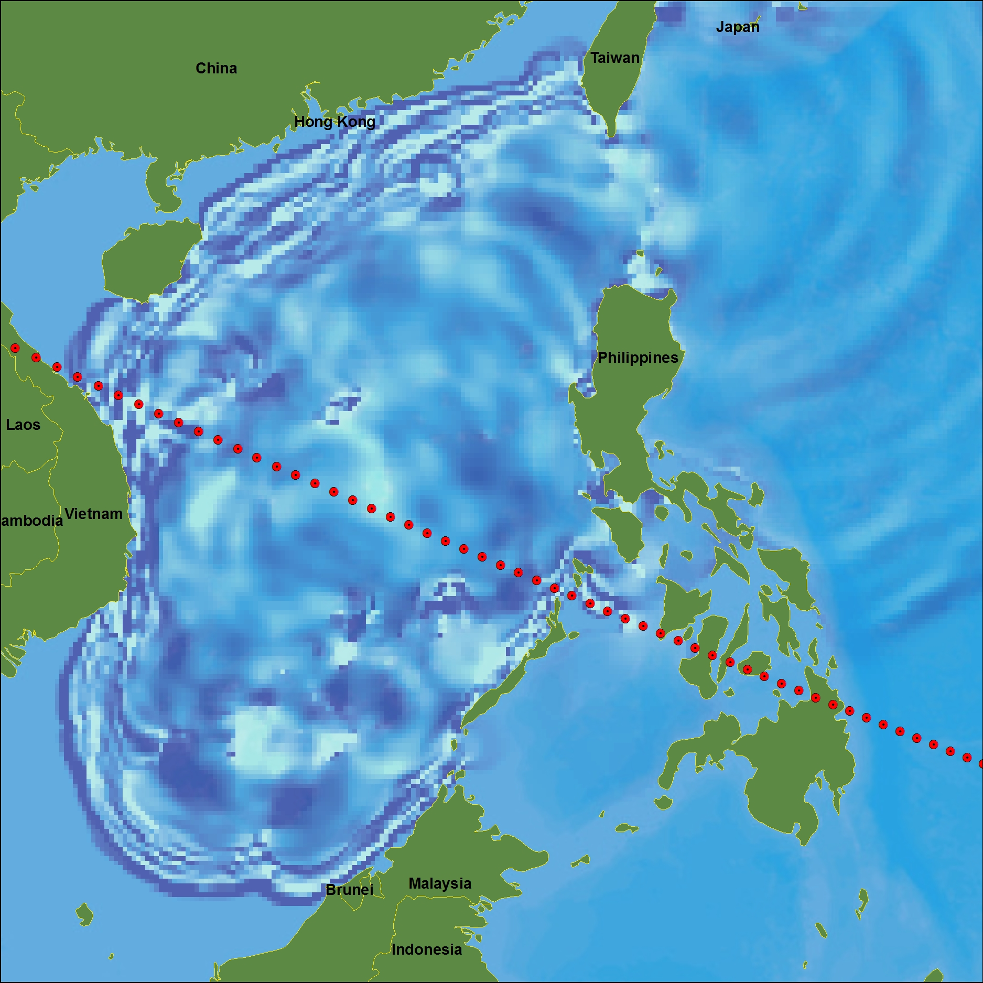
Tsunami From 100-m Fragment

Slide 4
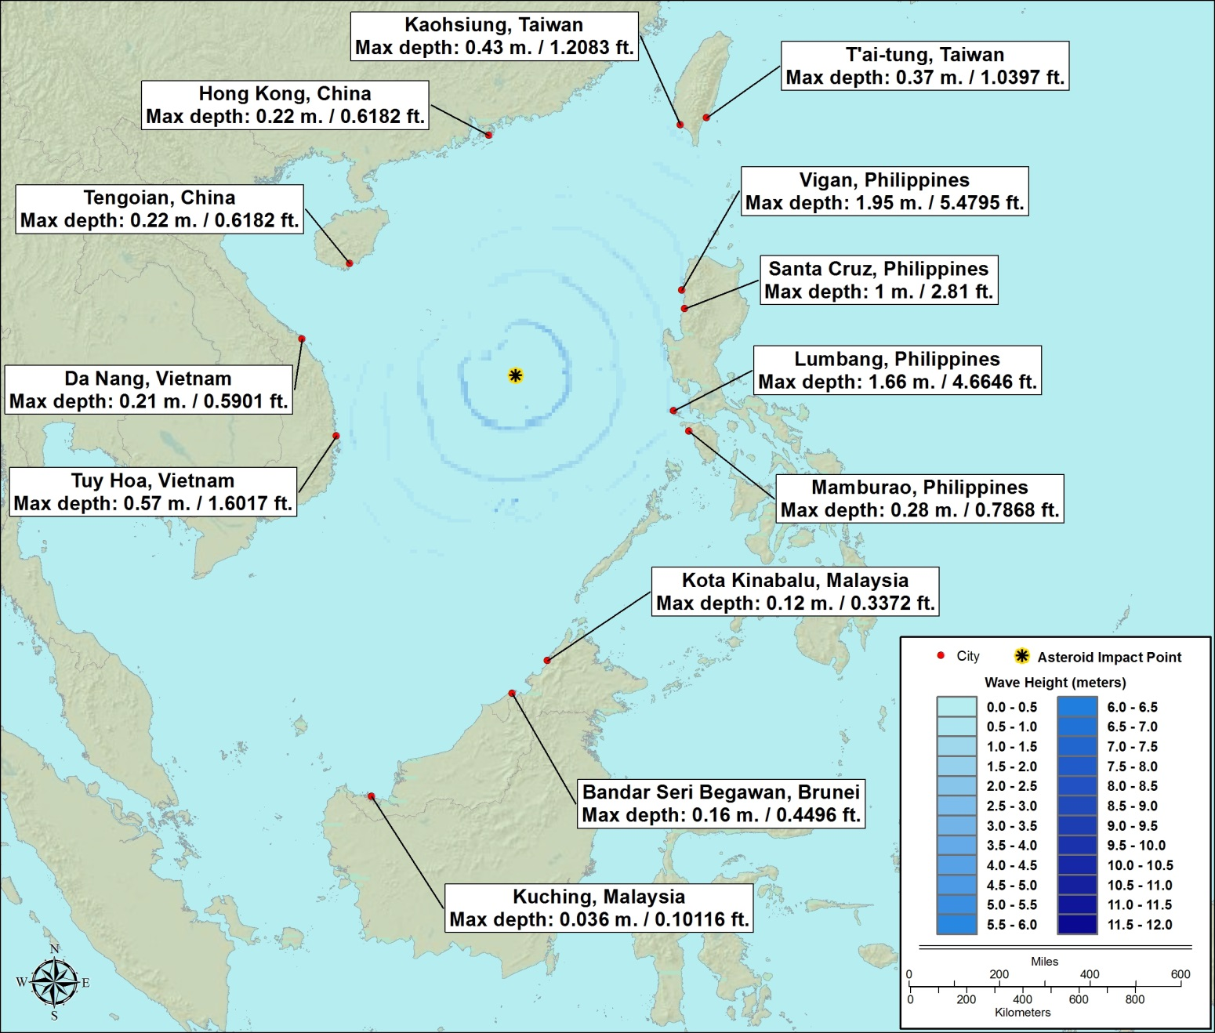
Tsunami From 100-m Fragment

Slide 5
There are two types of Low-Altitude Airburst
Type 1: Tunguska
Type 2: Libyan Desert
Local catastrophe
Bigger local catastrophe

Slide 6
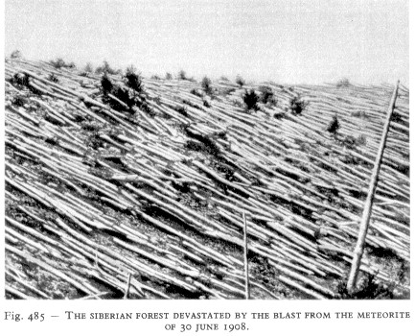
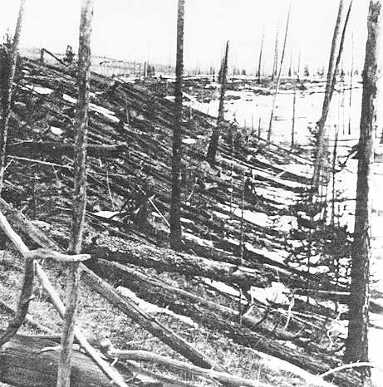
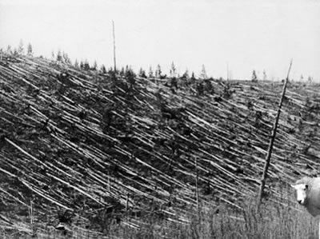
Tunguska:
June 30, 1908
Notes:
Tunguska: June 30, 1908

Slide 7
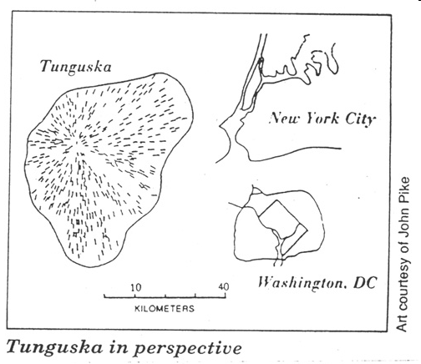

Slide 8
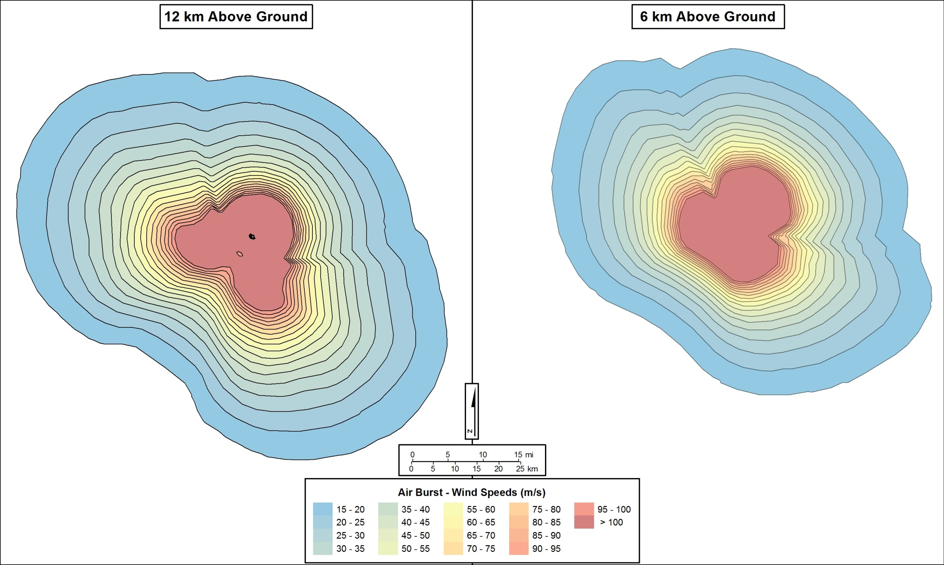
Wind contour maps from airburst

Slide 9
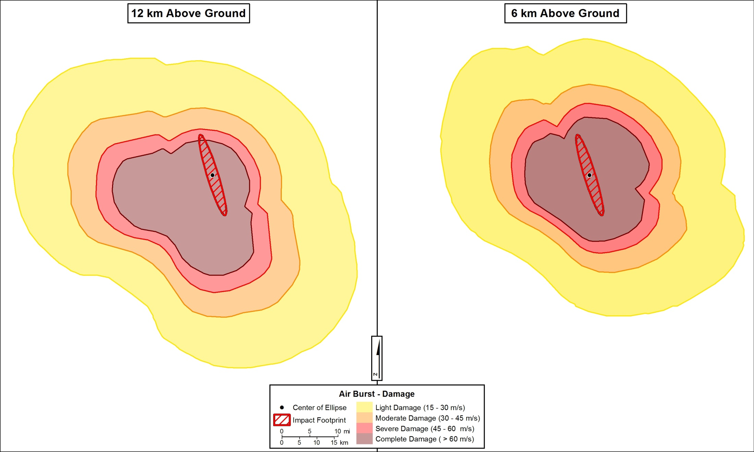
Extent of expected airburst damage (preliminary)

Slide 10
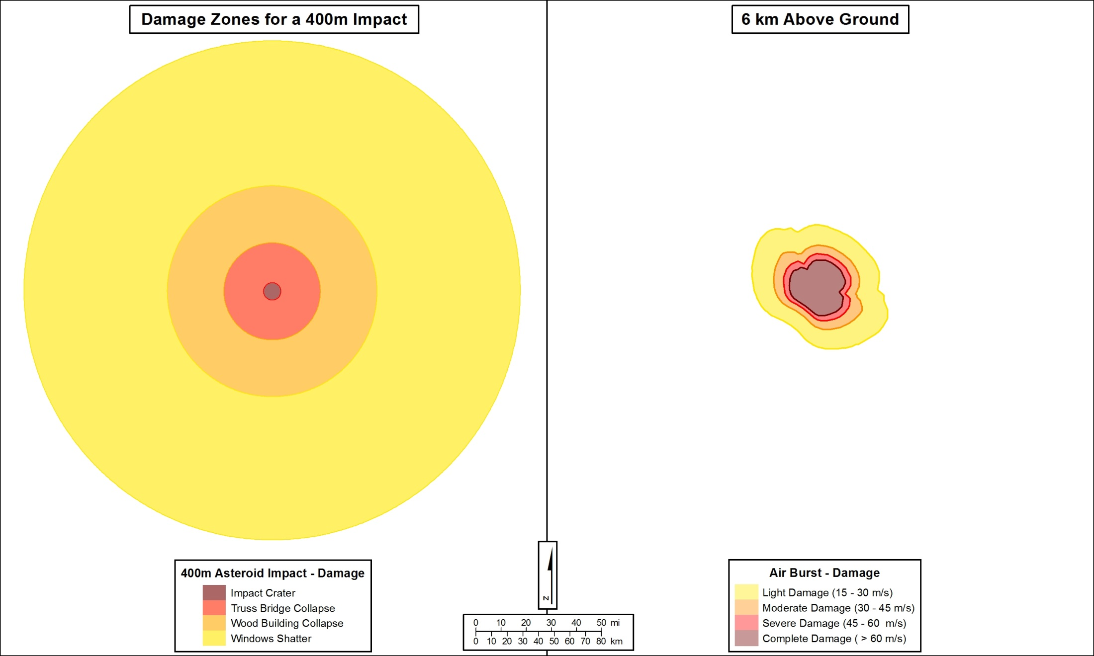
Comparison of Damage Zones

