Slide 1

Inject 3
Physical and Infrastructure Effects Briefing
December 27, 2016
2015 PDC
Mark Boslough & Barbara Jennings
Sandia National Labs
Albuquerque, NM
Bill Fogleman, GRIT – Mapping
Paul Chodas – JPL - Trajectory
Souheil Ezzedine – LLNL – Tsunami
EXERCISE
Sandia is a multiprogram laboratory operated by Sandia Corporation, a Lockheed Martin Company,
for the United States Department of Energy under contract DE-AC04-94AL85000.
Notes:
August 1972 fireball over western US

Slide 2
What we have been told
Entry speed: 16 km/s (36,000 mph, ~mach 47)
Size: Up to 400 meters diameter
Composition: Stone, density 2.2-3.3 g/cm³
2250 Megaton impact cannot be ruled out
Impact is certain: September 3, 2022

Slide 3
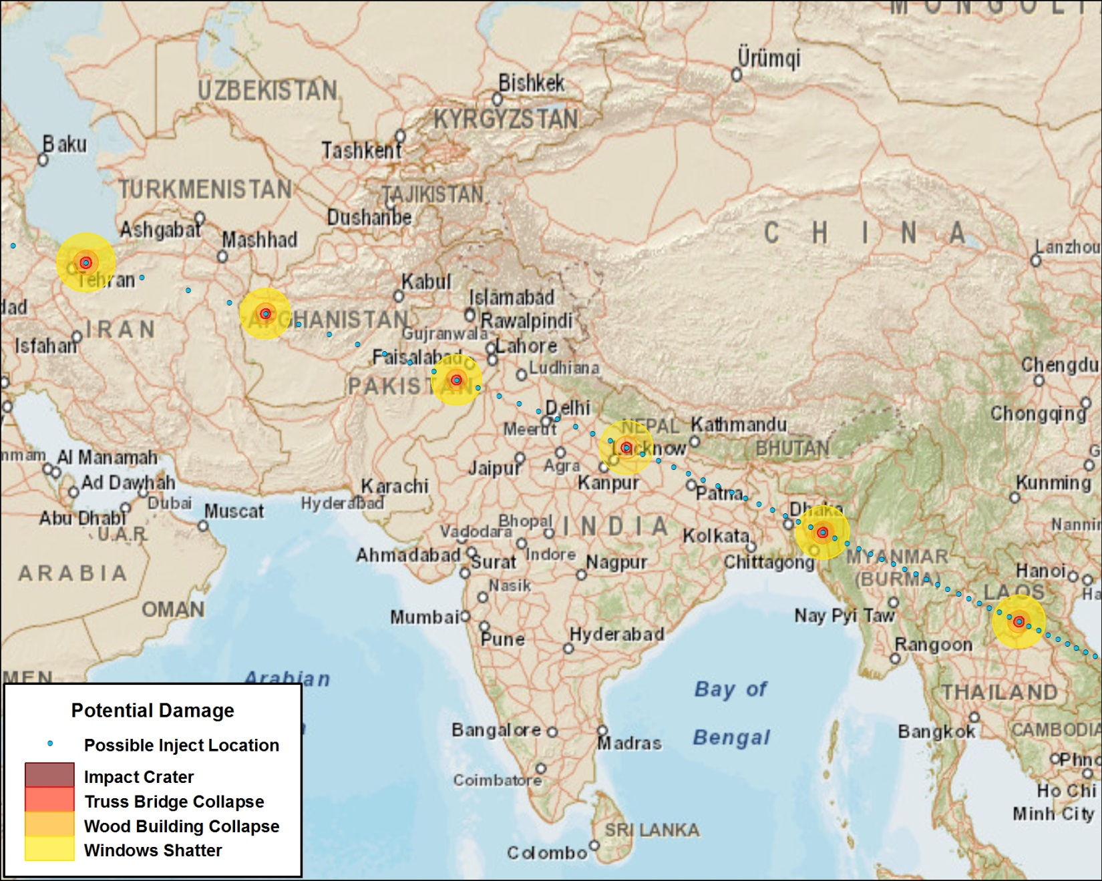
Possible Impact Locations
EXERCISE

Slide 4
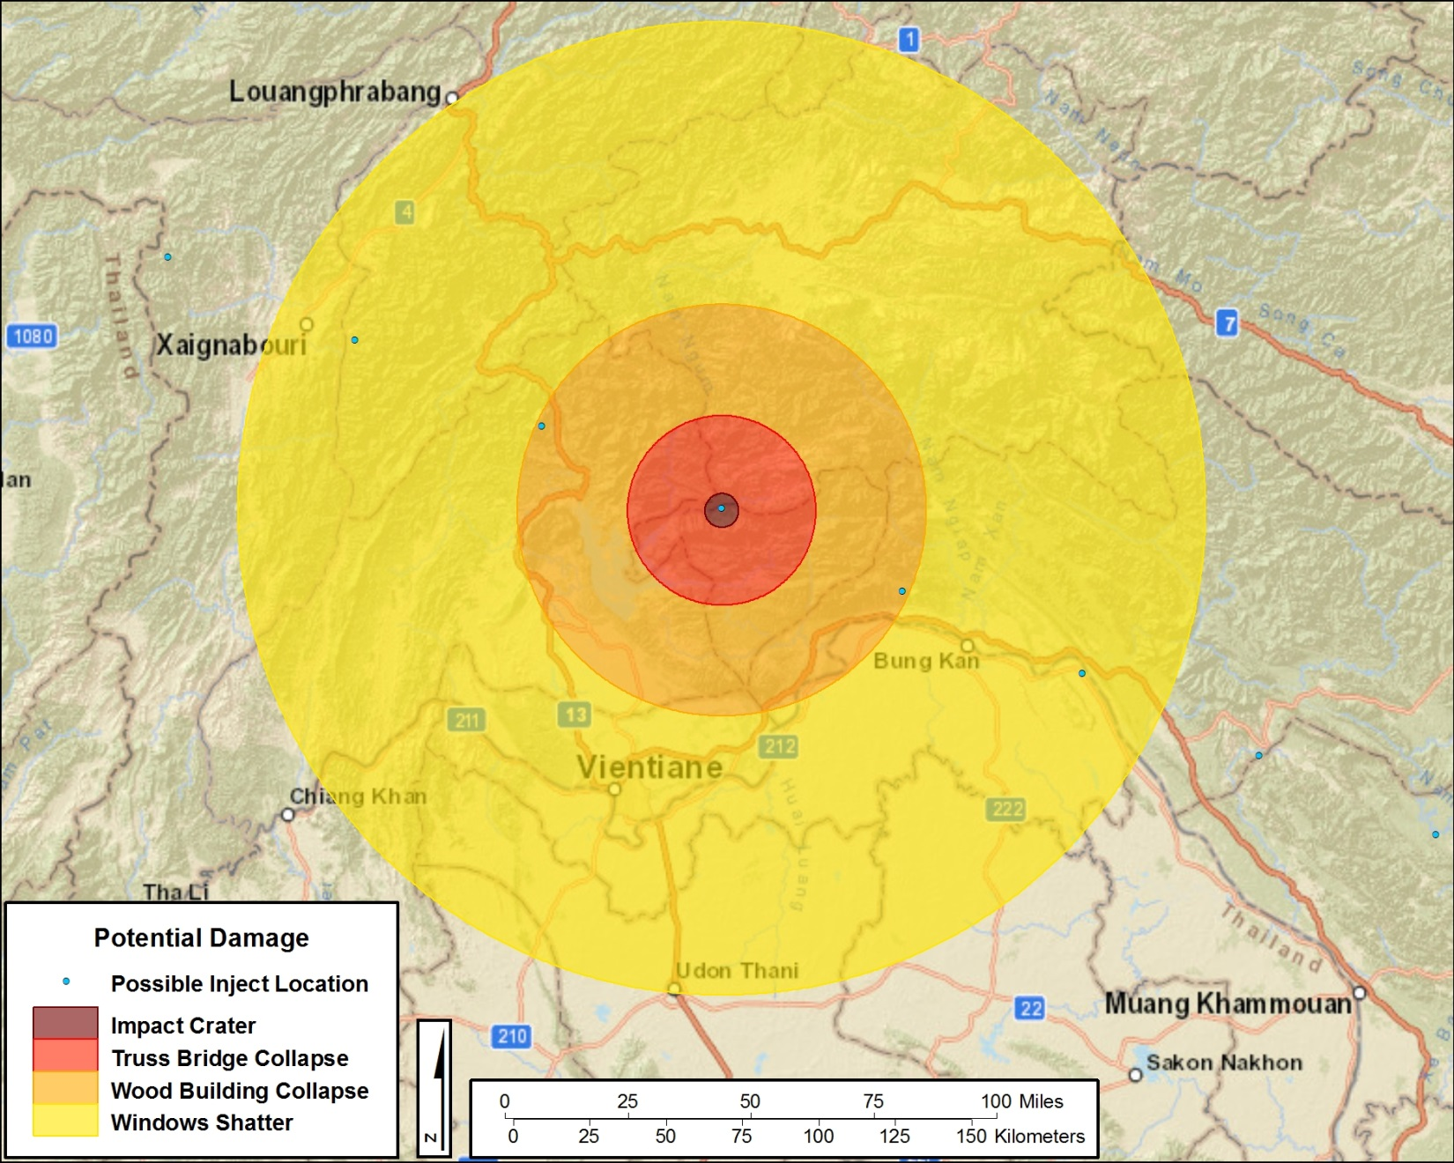
Purdue Simulator
Infrastructure Risk Zones
EXERCISE

Slide 5
Vientiane, Laos
Impact Results
Impact crater 5-7 km diameter
500 meters deep
6.8 magnitude earthquake
Damage Zones:
  Impact – total destruction
  29 km out – Total
  63 km out – Severe
  149 km – Light to Moderate
Fireball would cause trees to ignite
Individuals not sheltered will sustain 2nd degree burns
Winds of 60 m/s blowing over 30% of trees and stripping leaves and branches

Slide 6
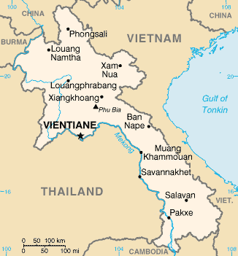
Vientiane, Laos - At Risk
Capital of Laos
Population 210,000
- 700,000 in Vientiane Prefecture
Situated on the Mekong River
Main roads are parallel to river
Main government offices and Presidential Palace are here
That Luang Stupa – most important religion monument in Laos
International Airport
16 Provinces

Slide 7
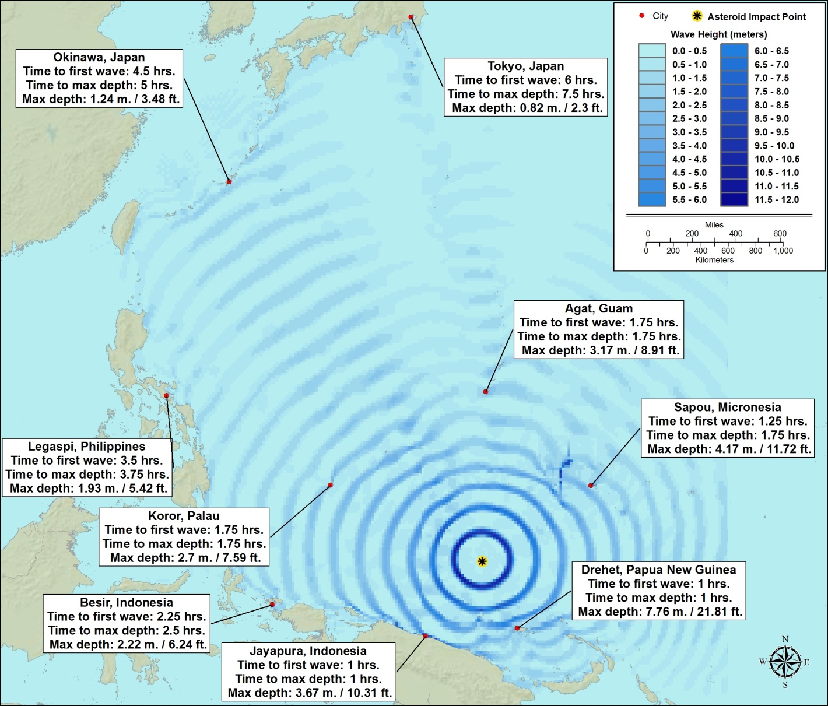
Tsunami is by far the greatest threat
We have run high-performance computer simulations
Western Pacific Impact - Steep entry: strong tsunami

Slide 8
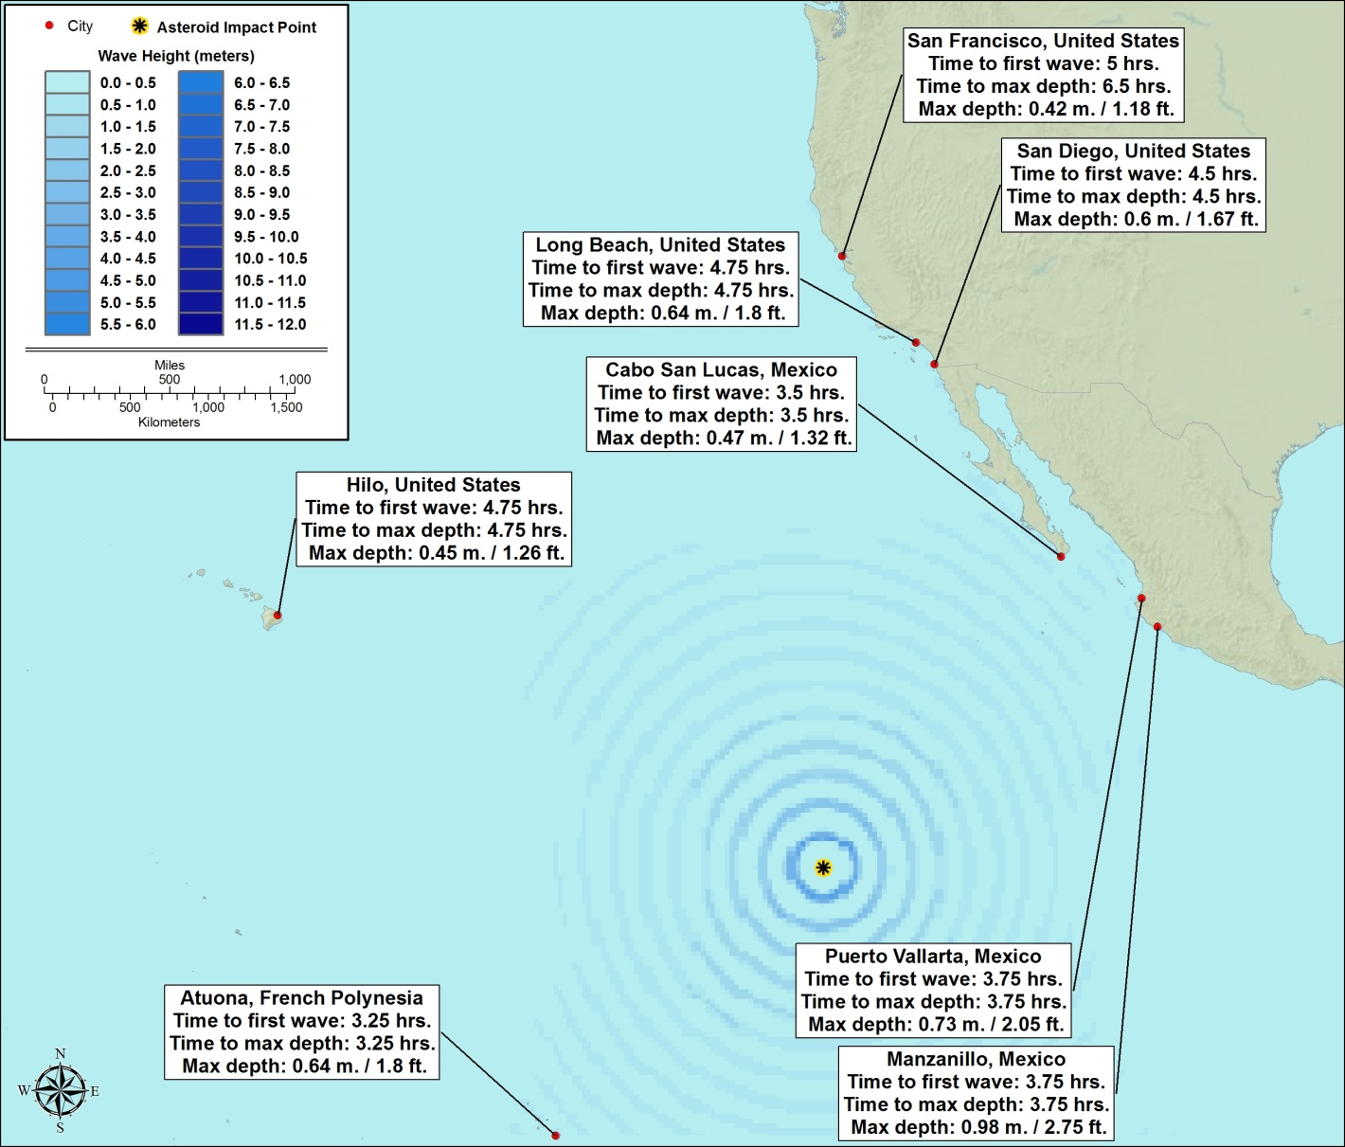
Tsunami is by far the greatest threat
We have run high-performance computer simulations
Eastern Pacific Impact - Grazing entry: weaker tsunami

