Slide 1

Inject 2
Physical and Infrastructure Effects Briefing
April 4, 2016
2015 PDC
Mark Boslough & Barbara Jennings
Sandia National Labs
Albuquerque, NM
Bill Fogleman, GRIT – Mapping
Paul Chodas – JPL - Trajectory
Souheil Ezzedine – LLNL – Tsunami
EXERCISE
Sandia is a multiprogram laboratory operated by Sandia Corporation, a Lockheed Martin Company,
for the United States Department of Energy under contract DE-AC04-94AL85000.
Notes:
August 1972 fireball over western US

Slide 2
What we have been told
Entry speed: 16 km/s (36,000 mph, ~mach 47)
Size: Up to 400 meters diameter
Composition: Stone, density 2.2-3.3 g/cm³
2250 Megaton impact cannot be ruled out
Impact probability: 43%

Slide 3
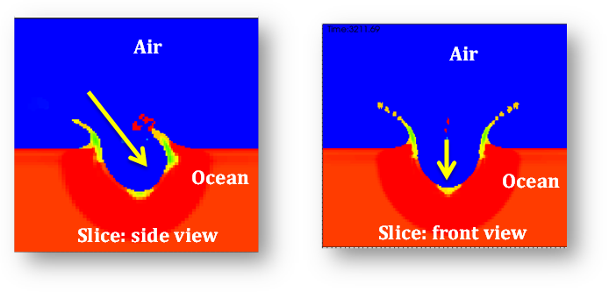
Tsunami is by far the greatest threat
We have run high-performance computer simulations
Tsunami strength depends on entry angle which depends on impact location and varies from near-grazing to 72°

Slide 4
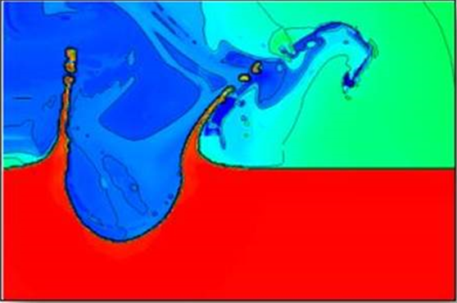
Tsunami is by far the greatest threat
We have run high-performance computer simulations
Tsunami strength depends on entry angle which depends on impact location and varies from near-grazing to 72°

Slide 5
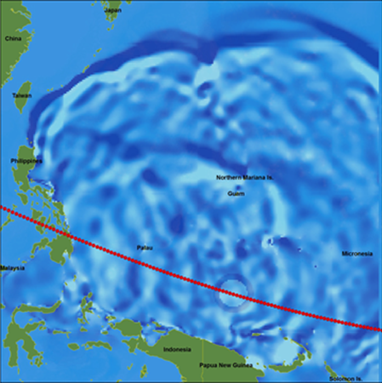
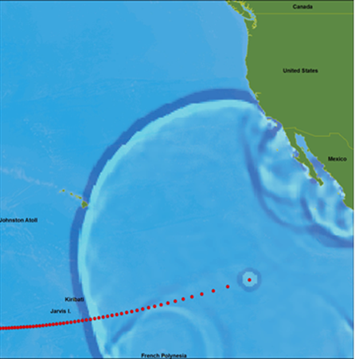
Tsunami is by far the greatest threat
We have run high-performance computer simulations
Western Pacific Impact
Eastern Pacific Impact
Steep entry: strong tsunami
Grazing entry: weaker tsunami
Tsunami strength depends on entry angle which depends on impact location and varies from near-grazing to 72°

