Slide 1

June 9, 2015
2015 PDC
Inject 1
Physical and Infrastructure Effects Briefing
Mark Boslough & Barbara Jennings
Sandia National Labs
Albuquerque, NM
Bill Fogleman, GRIT – Mapping
Paul Chodas – JPL - Trajectory
Souheil Ezzedine – LLNL – Tsunami
EXERCISE
Sandia is a multiprogram laboratory operated by Sandia Corporation, a Lockheed Martin Company,
for the United States Department of Energy under contract DE-AC04-94AL85000.
Notes:
August 1972 fireball over western US

Slide 2
What we have been told
Entry speed: 16 km/s (36,000 mph, ~mach 47)
Size: up to 400 meters diameter
Composition: Stone, density 2.2-3.3 g/cm³
2250 Megaton impact cannot be ruled out
Probability of impact = 0.9%
EXERCISE

Slide 3

Rapid estimate tool

Slide 4
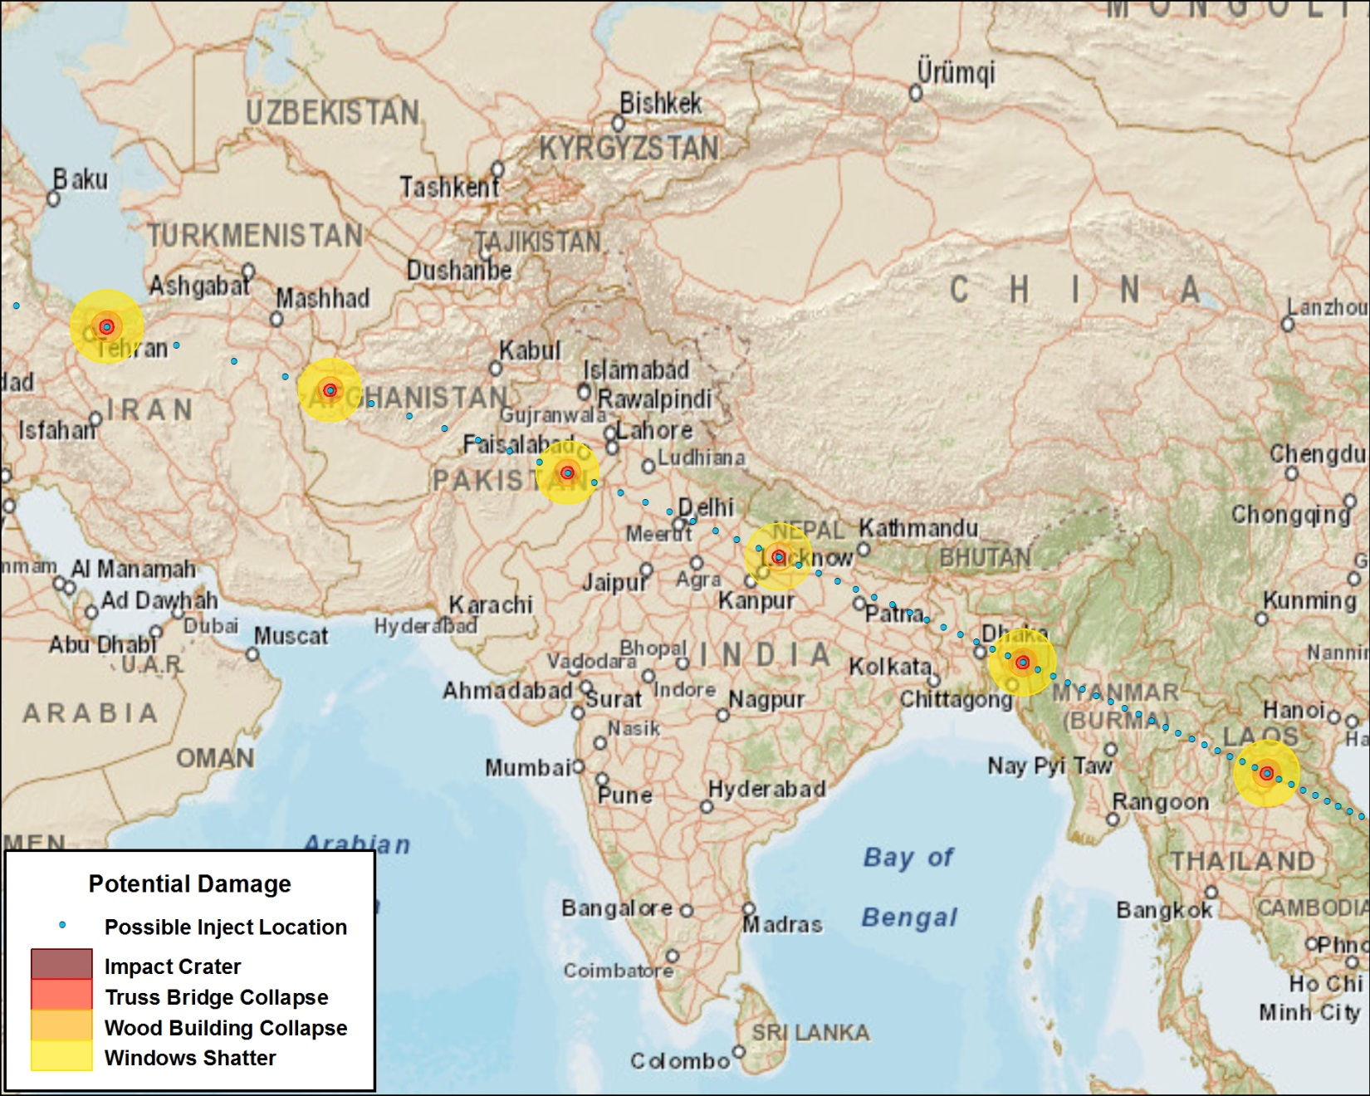
Possible Impact Locations
EXERCISE

Slide 5
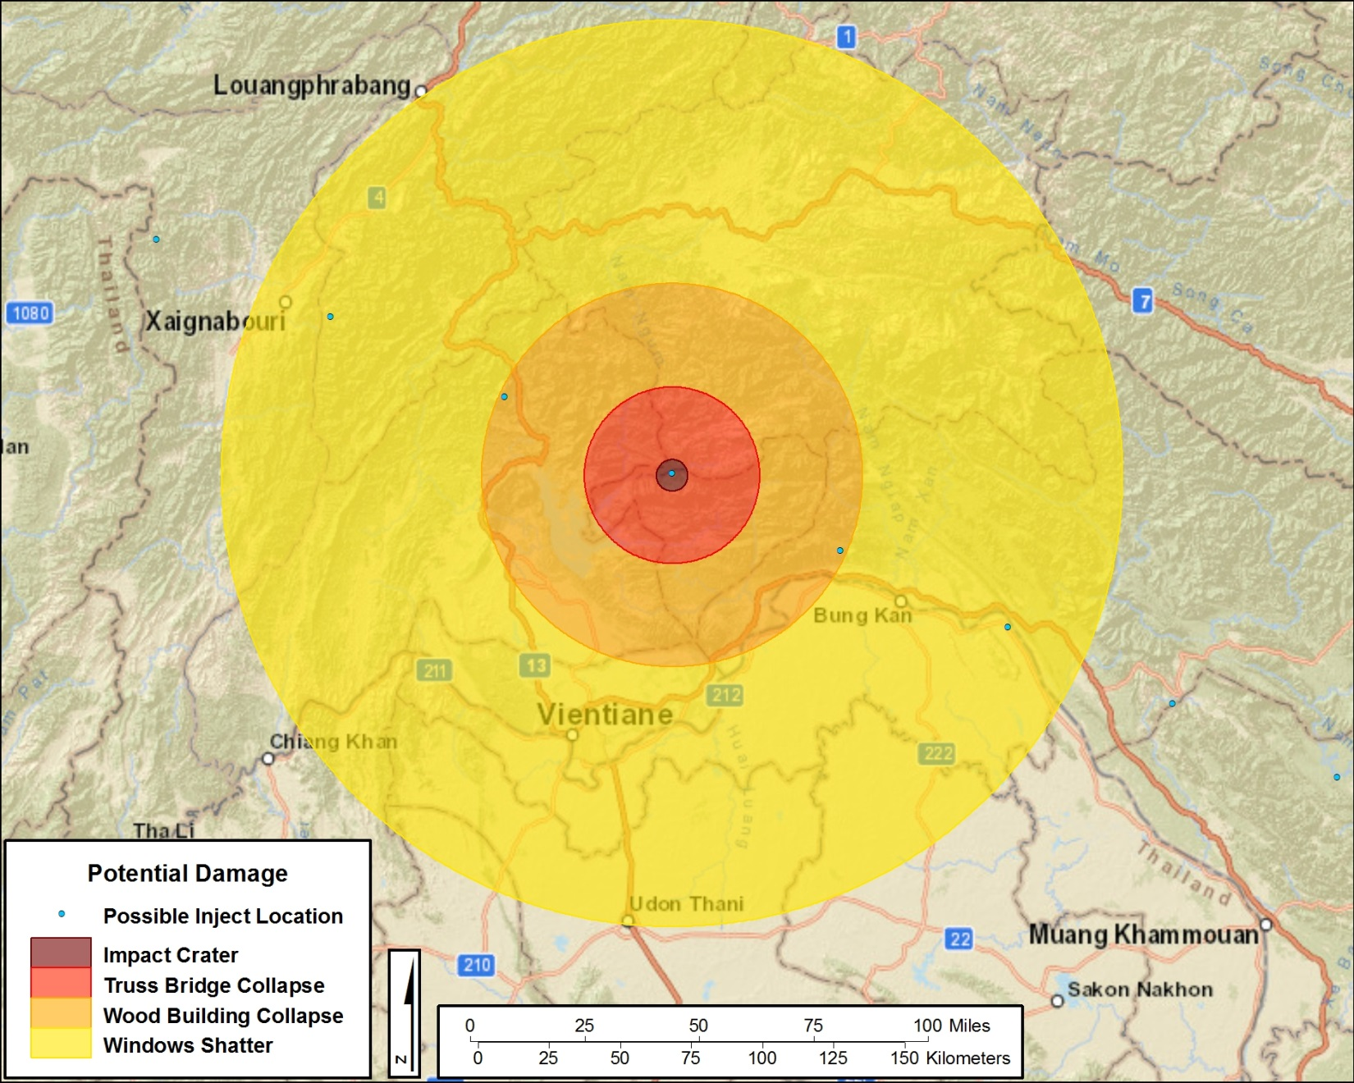
North of Vientiane, Laos

Slide 6
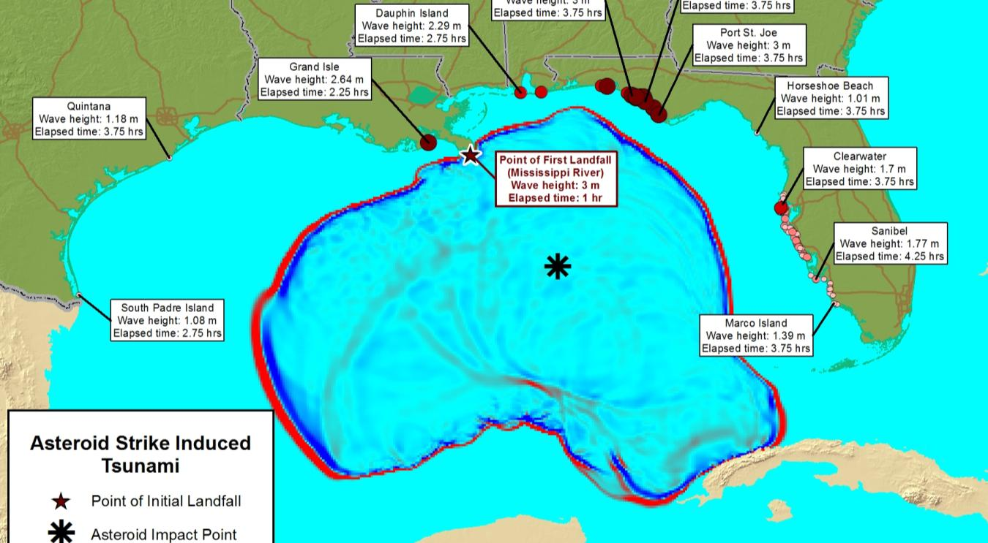
Greatest threat is tsunami
Highest priority is to run simulations as we did for 2014 FEMA exercise.
Example: Gulf of Mexico (not within current threat corridor).

Slide 7
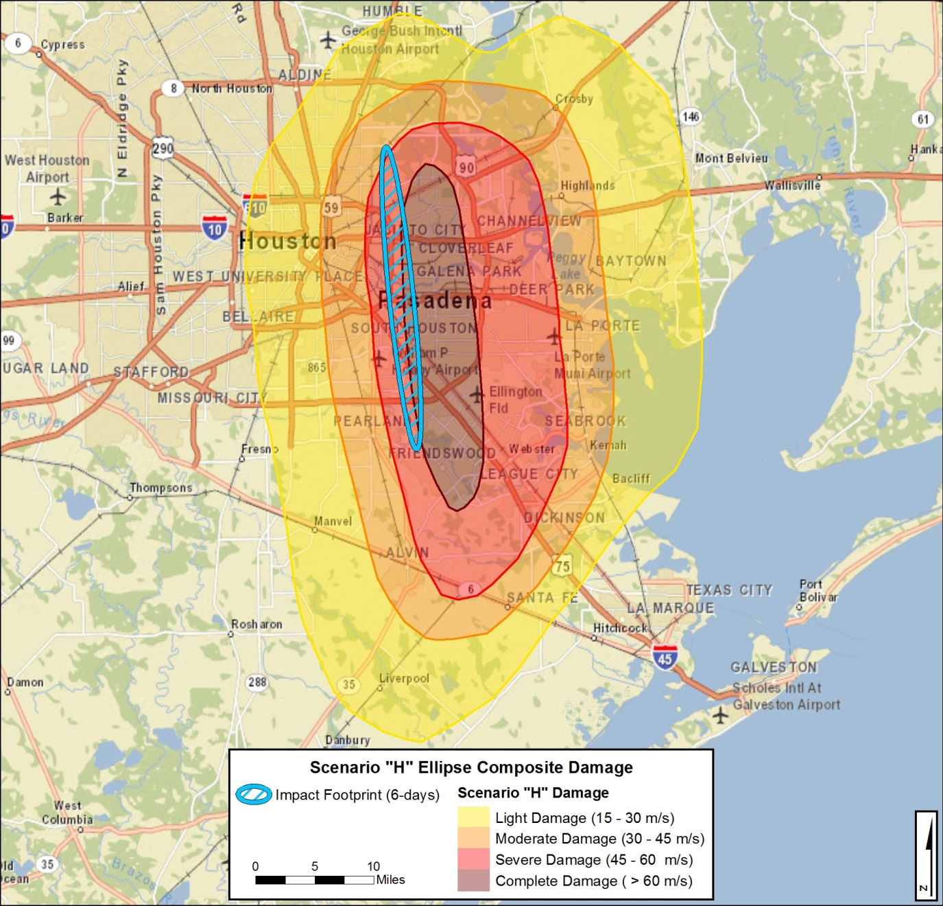
Example of Impact Damage Zones
From 2014 FEMA exercise

Slide 8
Wind From Airburst Likened to a Nuclear Blast
Pressure from a surface blast causes lateral dynamic loading; load applied rapidly for a second or more with continuously decreasing strength
Primary infrastructure damage due to overpressure and sustained wind at
  Severe; at 130 – 140 MPH (209 – 225 KMH)
  Moderate; 90 – 100 MPH (145 – 160 KMH)
  Light; 60 – 80 MPH ( 97 – 129 KM
Notes:
Lateral dynamic loading – load is applied rapidly and lasts for a second or more with continuously decreasing strength
Structures that are designed to be earthquake resistant and capable of withstanding a lateral load of 10% of their weigh will be the lase damaged
Reinforced structures a

Slide 9
Damage to Industry: POL, Utilities, Transportation
Structure | Severe | Moderate | Light
Petroleum, oil, lubricant tanks (POL) | 100% loss of fluids due to lifting of tanks from foundation | Loss of contents due to leakage; secondary effects; e.g. fires | Loss of liquid due to sloshing
Utility lines (above ground) | 100% supporting poles down | 30% supporting poles damaged | All poles in tact – few lines down, undamaged
Rail | 100% track and rail cars | Track in place cars blown over | Cars may be off track and sustain light damage
Parked transport planes, light aircraft, helicopters | 100% to exposed | Operational damage due to being blown over or other planes and debris | Field maintenance may be required

Slide 10
Damage to Industrial Structures
Structure | Complete | Heavy | Moderate
Wooden structure un-reinforced | Frame shattered resulting in almost complete collapse. | Wall framing cracked. Roof severely damaged. Interior partitions blown down. | Windows and doors blown in. Interior partitions cracked.
Light corrugated steel | Complete distortion or collapse of frame. | Minor to major distortion of frame. | Windows and doors blown in. Siding ripped off.
Heavy steel-frame industrial building | Severe distortion, collapse of frame. | Some frame distortion. Not operable. | Windows and doors blown in. Siding ripped off.
Concrete and steel reinforced | Walls shattered, frame distortion, initial collapse. | Walls breached to the point of being distorted. Doors blown in. | Cracking of concrete walls and frame.
Notes:
Structural response based on
“Strength” or massiveness of construction
Resilience and ductility

